Slide 1
Scheduling-in-DS
Lecture-24

Slide 2
Introduction
In a DS, normally each processor does its own local scheduling, without regard to other processors are doing.
Usally, this approach works fine. However, when a group of related, heavily interacting processes are all running on different processors, independent scheduling is not always the most efficient way.
The basic difficulty can be illustrated by an example, in which, processes A and B run on one processor and processes C and D run on another.
Each processor is time-shared, say, 100 ms time-slices, with A and C running in the even slices and B and D running in the odd slices, as shown in Fig. 4-20(a) (next slide)
Suppose that A sends many messages or makes many RPC calls to D.
During time-slice 0, A starts up and immediately calls D, which unfortunate is not running because it is now C’s turn.
After 100 ms, process switching takes place, and D gets A’s message, carries out the work, and quickly replies.

Slide 3
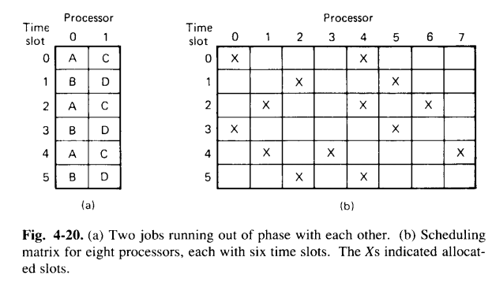
Cont..
Because B is now running, it will be another 100 ms before A gets the reply and can proceed.
Thus, the net result is one message exchange requires 200 ms. What is needed is a way to ensure that processes that communicate frequently, must run simultaneously.

Slide 4
Cont..
To solve the previous problem, Ousterhout (1982) proposed several algorithms based on the concept of co-scheduling, which takes IPC patterns into account while scheduling to ensure that all members of a group run at the same time.
The first algorithm uses a conceptual matrix in which each column is the process table for one processor, as shown in Fig. 4-20 (b).
Thus, column 4 consists of all the processes that run on processor 4.
Row 3 is the collection of all processes that are in slot 3 of some processor starting with the process in slot 3 of processor zero, then the process in slot 3 of some processor, starting with the process in slot 3 of processor 0, then the process in slot 3 of processor 1 and so on.
The gist of his ideas is to have each processor use a Round Robin scheduling algorithm with all processors first running the process in slot 0 for a fix period, then all processors running the process in slot 1 for a fix period, and so on.
A broadcast message could be used to tell each processor when to do process switching, to keep the times slice synchronised.

Slide 5
Cont..
By putting all the members of a process group in the same slot number but on different processors, one has the advantage of N-fold parallelism with a guarantee that all the processes will be run at the same time to maximize communication throughput.
Thus, in figure 4-20, 4 processes that must communicate should be put into slot 3 on processors 1,2, 3, and 4 for optimum performance.

